Slide 1
Virtualizer Studio: TLM Creation
Quickstart Training – Test Driven Design Methodology
© 2024 Synopsys, Inc. All Rights Reserved
Notes:
Welcome to the module 2 of the TLMC QuickStart training - Test Driven Design Methodology!

Slide 2
CONFIDENTIAL INFORMATION
The information contained in this presentation is the confidential and proprietary information of Synopsys. You are not permitted to disseminate or use any of
the information provided to you in this presentation outside of Synopsys without prior written authorization.
IMPORTANT NOTICE
In the event information in this presentation reflects Synopsys’ future plans, such plans are as of the date of this presentation and are subject to change. Synopsys is not obligated to update this presentation or develop the products with the features and functionality discussed in this presentation. Additionally, Synopsys’ services and products may only be offered and purchased pursuant to an authorized quote and purchase order or a mutually agreed upon written contract with Synopsys.

Slide 3
Agenda
Introduction
  Virtualizer Studio Overview + TLM Creation Flow
Part 1: Model Skeleton Creation
  Model interfaces, memories, registers, build settings, IP-XACT import, etc.
Part 2: Test Driven Design Methodology
  Unit testing framework, test utilities, functional coverage, etc.
Part 3: Model Behavior Implementation
  Default and custom callbacks, continuous assignments, etc.
Part 4: Model Debugging
  SystemC debugging, using FastTrack messages, source code debugging, etc.
Part 5: Import of Existing SystemC Models
Part 6: Model Integration in Virtual Prototype Design
Notes:
Look into the overview to get an insight into the training contents.

Slide 4

Objectives
After completing this module, you should be able to use:
The VDK Creation Methodology to develop the TLM models - Test Driven Design (TDD) approach
The TLMC Unit test framework and infrastructure for the generated Model
  Add unit tests to validate the model features
  Use FastTrack messages
  Create and understand basic functional coverage reports
  Run the tests and review the results
  Debug issues using a source code debugger

Slide 5
Revisit
  VDK Creation Methodology – TLM Model Creation
Notes:
This section explains the VDK Creation Methodology to be used in the model creation flow.

Slide 6

VDK Creation Methodology – TLM Model Creation
Test Driven Design (TDD)
ITERATIVE
Design Model
Create Test Plan
Add Behavior
Testing & Debugging
Export
  Study Specs
  Decide on the Model Architecture
  Interfaces, Storage, Parameters,
  Tracker Feature List
  Setup Component Tests
  For each feature in the spec, add a Component Test
  Implement Functional Behavior
  Add FastTrack logging
  Build & Run Component Test Suite
  Perform Model Source Code Debug
  Author Model Documentation
  Build & Package Model
  Generate Component Library (XML Representation)
Notes:
Synopsys VDK Creation Methodology provides a proven methodology for creating both TLM models, and VDKs.
The TLM Model creation flow starts with the model specification. You need to review the requirement specs, to decide on the model architecture by selecting the model interfaces, internal MemoryMap and register specification, parameters to be used, and so on. As an outcome of this step, you would also be creating a Tracker Feature List, listing all the required features of the model.
Following a test driven design approach or TDD, you will first need to create a test plan and unit tests for a logical chunk of features from the tracker as desired. and then, add the required functional behavior code in the source files. You should be adding the associated documentation, and Virtualizer FastTrack logging to your functional C++ code, for better debugging support later when the model is used.
Once behavior is added, the component test suite needs to be built and run on the model implementation, so as to ensure functional correctness. To analyze the test results, you can also make use of the integrated source code debugging support.
All steps from model design to testing, and debugging need to be executed iteratively, till all the model features are implemented and tested.
Next, you come to the last step to generate and package the model implementation for exporting. You should enhance the generated documentation, and create Model Component Library, for final packaging.
The TLM Creation technology of Virtualizer Studio, supports this flow and provides a complete model creation solution. Next, lets see how it works.

Slide 7
Component Testing
  Test Infrastructure Overview
  Writing Component Tests
  FastTrack Overview
  Running Tests
    Functional Coverage
  Debugging Source Code
Notes:
This section explains the overview of the Test infrastructure for the generated Model and how to add the Unit tests to validate the model features. Next, we will cover how to run the unit tests and make sure the tests pass. Lastly, Use of supported Source code debuggers is also explained.

Slide 8
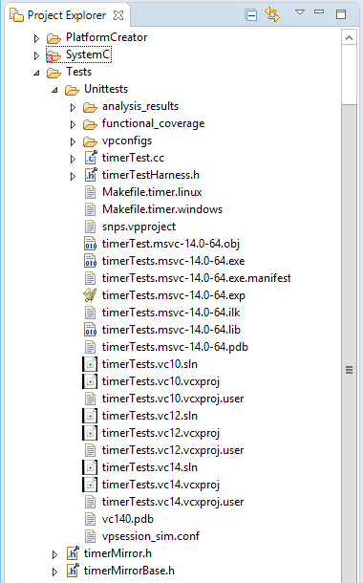
Infrastructure Overview
Component Test Setup
Model
MirrorModel
Component Test Infrastructure
SystemC Aware Assertions
Component Test Class
void write_TheRegister() {
P.write32(TheRegister, 0x01);
SCML2_ASSERT_THAT(
P.read32(PERIOD.equals(0));
}
Model Unit Test Source File: Source Code for Actual Component Tests
Base Class for Tests: Creates Test Infrastructure for the Model
Mirror Model Header File: Can be extended to include Additional Test
Structures (e.g. Test Models)
Mirror Model Base Class: Always regenerated
Notes:
Lets take a look at the component testing Framework generated by the TLM Creator technology of Virtualizer Studio. Along with the TLM model, its mirror model also gets created with exactly the same number of ports. The ports are of opposite types so that they can be connected. Virtualizer Studio features a Unit Test Runner, which automates the running and scoping of test results. The Unit Test Runner manages the build and execution of the design consisting of the model, and its mirror model.
The Framework provides SystemC-aware assertions as well as the test macros to quickly develop new unit tests. As most of the boilerplate code related to instantiation and connecting your testbench and model under test, so that you can simply focus on writing tests. Further, the test framework provides temporal assertions that involve behavior over time.
Lets look at the contents of the Test folder now. First, the model unit test source code, which contains the class constructor, destructor, initialize method, setup method, and default unit tests. Then, the base class for component tests, which creates the test infrastructure for the model.
Lastly, the mirror model implementation files, including Mirror Model Header File and Base class, which provides the code for the testbench.
Note that the unit test source code file and mirror model header file do not get regenerated by the tool, after you edit them once. This means that in case you want to make any further changes to these files such as adding more unit tests, after you have edited them once, you would need to maintain them on your own, and save them to ensure that your changes get reflected in the updated model version.

Slide 9
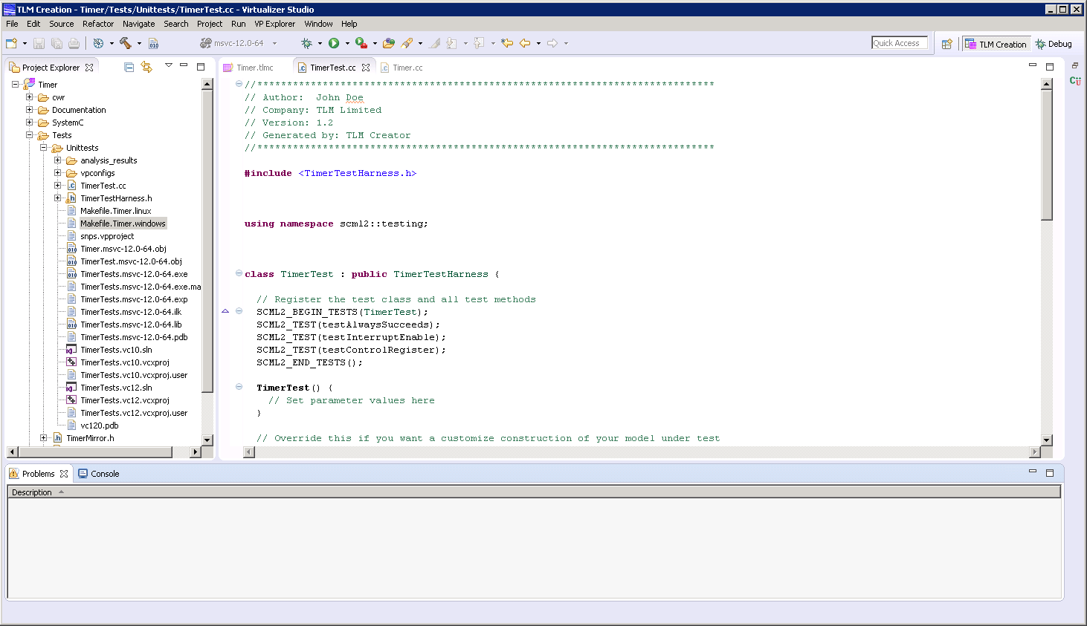
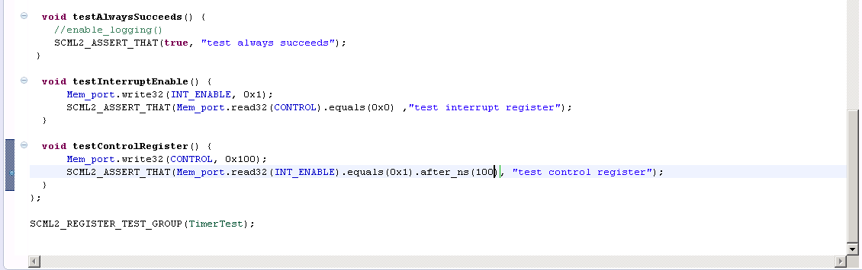
Writing Component Tests
TLM Creator provides SystemC-aware assertions as well as
the test macros to quickly develop new unit tests.
Test.cc
All the unit tests are to be registered in the constructor of the Component between the SCML2_BEGIN_TESTS and SCML2_END_TESTS macros
Each unit test is implemented as a member method with the same name as used in its registration
Initialize and setup methods are added to each test by default to define their initial state. Help Macros also aids in unit tests refining. Lets take a detailed look.
Notes:
The generated TimerTest.cc file contains a minimal testcase named, testAlwaysSucceeds. It is for the purpose of ensuring that everything builds and links, correctly.
Next, you add the component tests for your model. Each test is defined as a method of the TimerTest class. From the test, you can read or write to the interfaces of your model, through the mirror model interfaces that have the same name. The base addresses for all the registers are defined in the test infrastructure as well, so that you can use the register name in the address field of the read/write methods. To test the success or failure of the test, the infrastructure provides with a number of SystemC aware assertions.

Slide 10
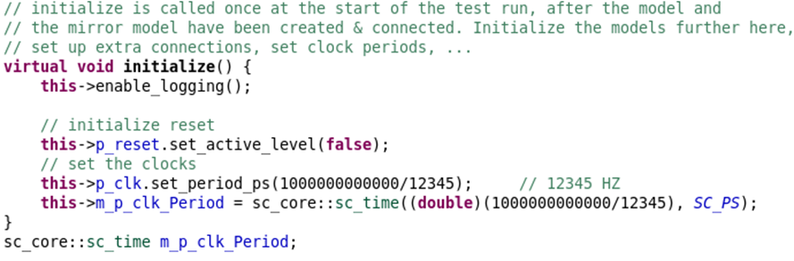
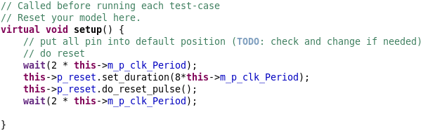
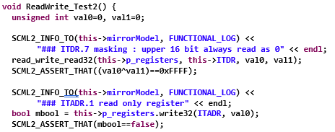
Writing Component Tests
initialize() method
˗ Enables logging with the help of the enable_logging() method
˗ Initializes the clock ports by writing a clock value to them
Enables logging and initializing
Allow some delays/waits to start from a settled state
setup() method
˗ It is called before each unit test runs
˗ Resets the model to make sure it is in a defined state (and not the state from the last test).
Help Macros
˗ SCML2_ASSERT_THAT: Checks a condition without terminating the test run on failure
˗ SCML2_INFO_TO: Logs messages (Generic use)
Use of the Help macros
Notes:
The generated TimerTest.cc file contains a minimal testcase named, testAlwaysSucceeds. It is for the purpose of ensuring that everything builds and links, correctly.
Next, you add the component tests for your model. Each test is defined as a method of the Test class. From the test, you can read or write to the interfaces of your model, through the mirror model interfaces that have the same name. The base addresses for all the registers are defined in the test infrastructure as well, so that you can use the register name in the address field of the read/write methods. To test the success or failure of the test, the infrastructure provides with a number of SystemC aware assertions.

Slide 11


FastTrack - Overview
Contains Implicit FastTrack support
SCML Objects
Model transition to an illegal state
Writing to a read-only register
Explicit FastTrack messages
TLM Model
Explicit FastTrack support, added by model author to model behavior
Notes:
The Virtualizer FastTrack technology provides a means of instrumenting the TLM model behavior with FastTrack messages which at run-time, provide additional information to the user of the model, about its specific execution state. Examples of this could be the wrong programming of a model, e.g. writing to a read-only register, or the model transition to an illegal state, as well as other situations like the indication that certain model behavior hasn’t been implemented yet.
The result of this unique feature is that the use of these models for embedded software development and debugging, becomes much more productive compared to other hardware alternatives, as the models can proactively flag erroneous conditions, wrong programming, etc. to the user. Along the same line, as another benefit these FastTrack messages make the model debugging, both during the development and later during its use, greatly more efficient, as they are no longer just compiled black box models, but rather intelligent proactive models.

Slide 12
FastTrack - Severity Levels
Errors
SCML2_ERROR (Error category)
SCML2_ERROR_TO (module, Error category)
// timer event handler
void timer::handle_pit_event(void){
SCML2_INFO(FUNCTIONAL_LOG) << "handle_pit_event()" << std::endl;
pit_reload();
// Set the interrupt flag and generate an interrupt if it's enabled.
this->ITSCR.ITSCR_ITIF = 1;
if (this->ITSCR.ITSCR_ITIE == 1) {
p_PITIRQ = 0;
SCML2_INFO(FUNCTIONAL_LOG) << " p_PITIRQ = 0 " << endl;
} else {
SCML2_WARNING(PROGRAMMING_WARNING) << " ITIE not set, so I am not
raising the interrupt " << endl;
}
pit_schedule();
}
bool timer::handle_read_ITSCR(unsigned int& value, const unsigned int& byteEnables) {
ACCESS_CHECK_32only(byteEnables);
value = (this->ITSCR & 0xFF) & byteEnables;
return true;
}
Info
SCML2_INFO (Info category)
SCML2_INFO_TO (module, Info category)
More on how these messages help in the debugging
flow is covered in the TLMC Training Session 4 on Model Debugging
Warnings
SCML2_WARNING (warning category)
SCML2_WARNING_TO (module, warning category)
Model Internal
SCML2_MODEL_INTERNAL (model internal category)
SCML2_MODEL_INTERNAL_TO (model internal category)
Notes:
Let’s talk about how to add FastTrack messages. The FastTrack messages can be of “implicit” or “explicit” type.
The implicit FastTrack messages, are built into the modeling objects of the Virtualizer SystemC Modeling Library, or SCML for short. They don’t require any extra work from the developer, and come for free. Examples are, setting the value of a SCML property outside of its specific range constraint, or writing to a read-only SCML register, etc.
The explicit messages can be inserted by the model author manually, during the development stage. The author has great flexibility in which type of information, he or she wants to provide to the model user. The FastTrack messages can be classified into four severity levels that is, “Error”, “Info”, “Warning” and “Model Internal”. Each severity has distinct categories, to further refine the message classification. The FastTrack infrastructure provides simple SCML2 convenience macros, to enable sending relevant messages to a C++ stream like object. To enable this feature for your TLM model, use a supported macro, and specify the severity, category, and a customized message, in the model source code.
For a complete listing of the supported categories, please refer to the Virtualizer Documentation set, or Review the Model header file.
Lets take a look at an example. Check out the SCML2_INFO API call with “Functional_Log” category as an argument, which indicates that this message conveys information about the high-level behavior of the model. Followed with a message to be streamed. The example also shows a SCML2_WARNING API call with the "Programming_Warning" category, and a relevant message, in case this condition strikes.
Next, let’s look at the run-time debug features that the FastTrack technology enables.

Slide 13
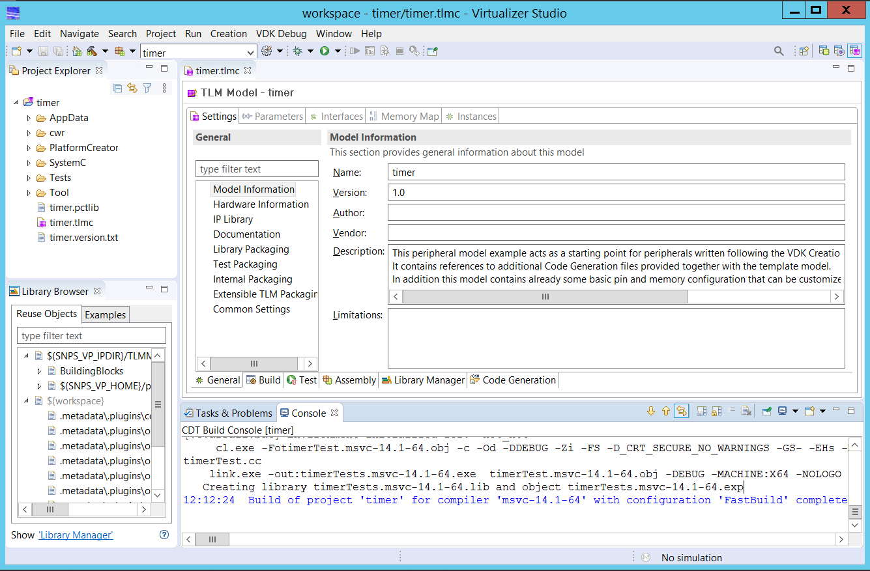
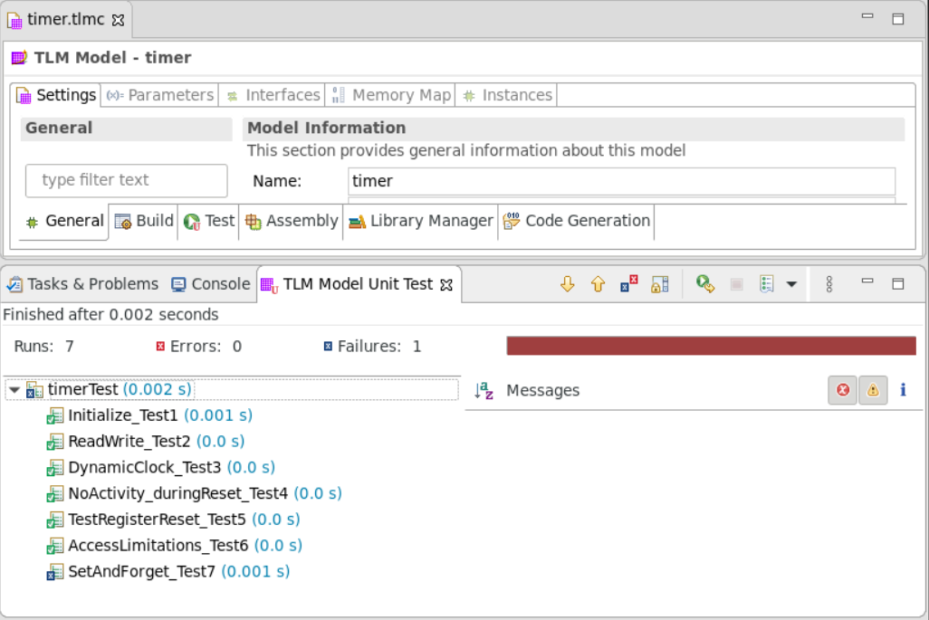
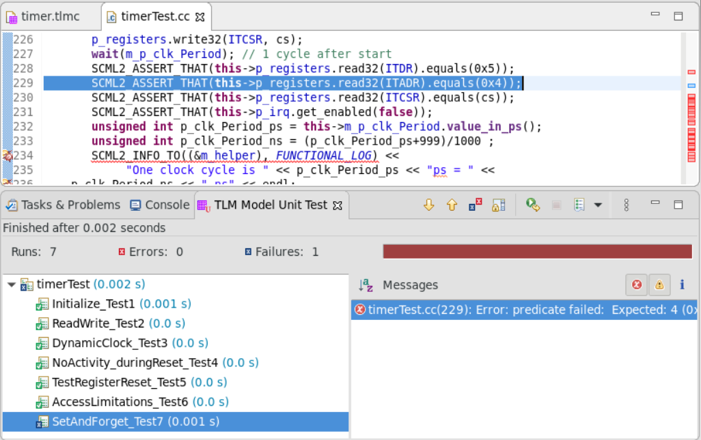
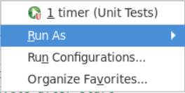


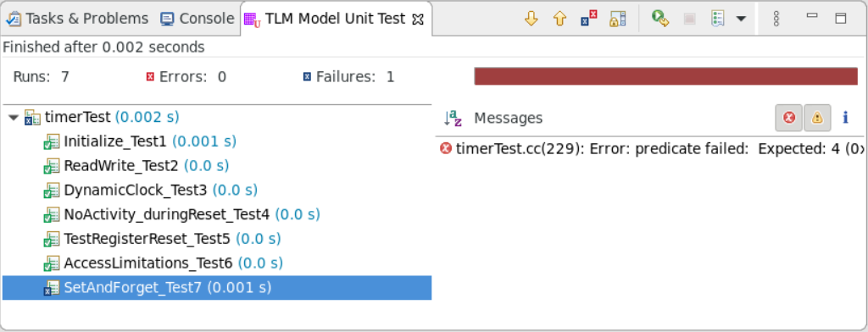
Running Component Tests
Launch Component Test
Code causing failing test message highlighted
Test Report in the TLM Model Unit Test view
Messages from the Failing Tests. Double-click to open the associated source code
Failing Tests. Click to open the related messages
Notes:
To run the component tests, simply click the Test Run option. The component tests run and a resultant report gets displayed in the TLM Model Unit Test view, listing the success or failure for each test. When you double-click on any message for a failing test in the Messages view, the affected source code file opens and the corresponding code gets highlighted.

Slide 14
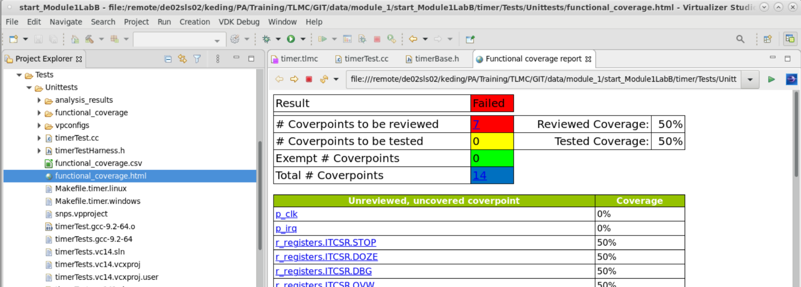
Functional Coverage – Automatic Generation
TLM Creator automatically generates a functional coverage report after every model unit test run to validate how well the tests cover all the features of the TLM component.
Functional report generated in the Unittests folder
Double-click to open the functional coverage report
Recommend approach is that the functional coverage should be done in the following two phases:
Phase I: First try to secure 100% Review coverage,
Phase 2: Then, continue to add more tests for getting 100% Tested coverage.
Notes:
To run the component tests, simply click the Test Run option. The component tests run and a resultant report gets displayed in the TLM Model Unit Test view, listing the success or failure for each test. When you double-click on any message for a failing test in the Messages view, the affected source code file opens and the corresponding code gets highlighted.

Slide 15
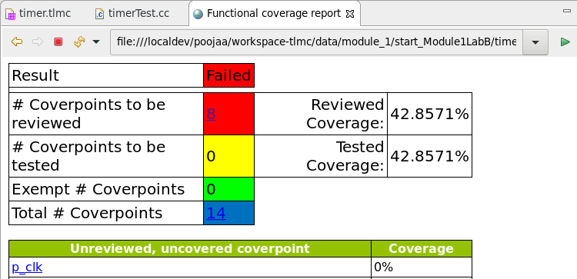
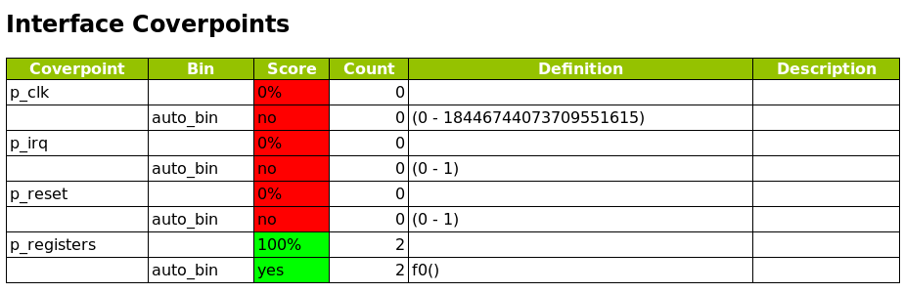
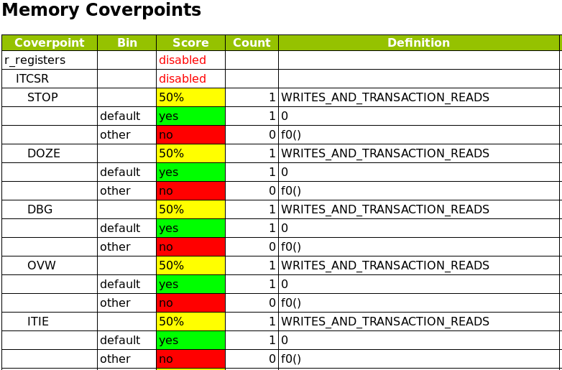
Functional Coverage – Report Sample
Overall result (Failed, In Progress, Pass)
Coverpoints can be marked as Exempted from the purview of coverage
Reviewed & Tested coverage percentage
Coverpoints not covered in the tests
Failed: Reviewed coverage < 100%,
In progress: Tested coverage < 100%
Pass: tested coverage == 100%
Interface and Memory individual coverpoints are also covered in detail
Notes:
Functional coverage process should be done in 2 phases: first get to 100% review coverage, and then continue with phase 2 of getting 100% Tested coverage.

Slide 16
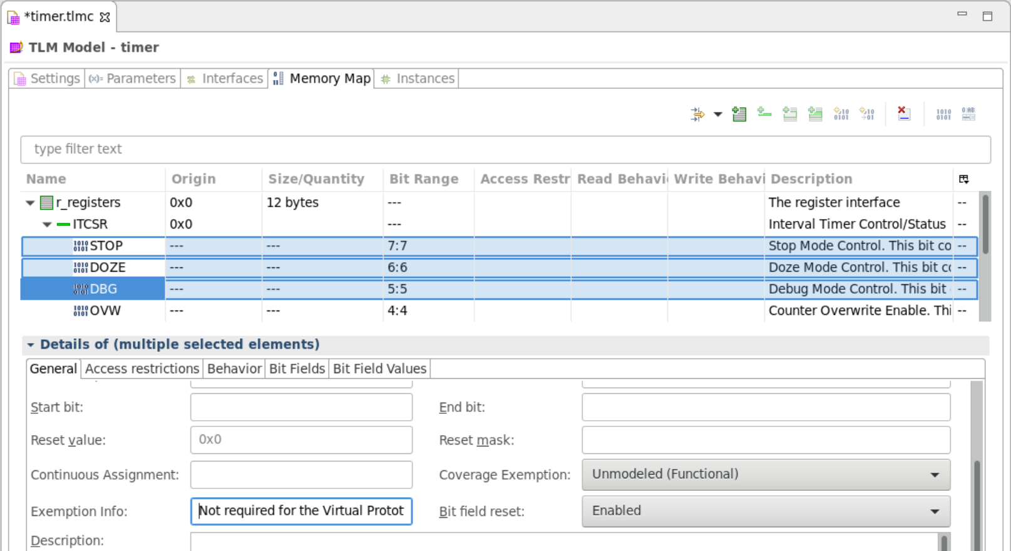
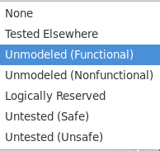
Functional Coverage – Exempting Coverpoints
Marking coverpoints as Exempted from the purview of coverage
Coverage Exemption field to be marked with the possible exemption reason such as Unmodeled (Functional)
Provide the reason or more info in the Exemption Info field
Notes:
To run the component tests, simply click the Test Run option. The component tests run and a resultant report gets displayed in the TLM Model Unit Test view, listing the success or failure for each test. When you double-click on any message for a failing test in the Messages view, the affected source code file opens and the corresponding code gets highlighted.

Slide 17
Hands On Labs on this topic
Module 1 Lab B: Test Driven Design with TLM Creator
  Your task for this lab is to create unit tests for the Timer model as against the features from the tracker list
Module 2 Lab D: Test and Coverage for the SPI Controller Model
  Your task for this lab is to create unit tests and coverage reports for SPI Controller Model
Notes:
Accompanied Lab Modules Overview !

Slide 18

Thank You

